Slide 1
F1M2ONT – HTML & CSS

Slide 3
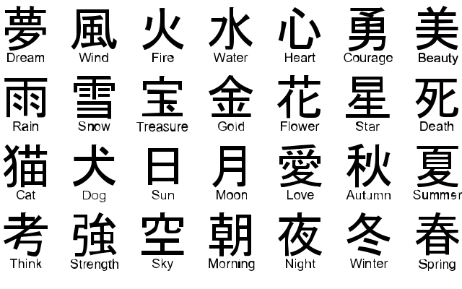

Slide 5
F1M2ONT
2 uur per week User Experience Design (UXD) => Erik Willems
2 uur per week HTML & CSS => Jeroen Rijsdijk

Slide 7
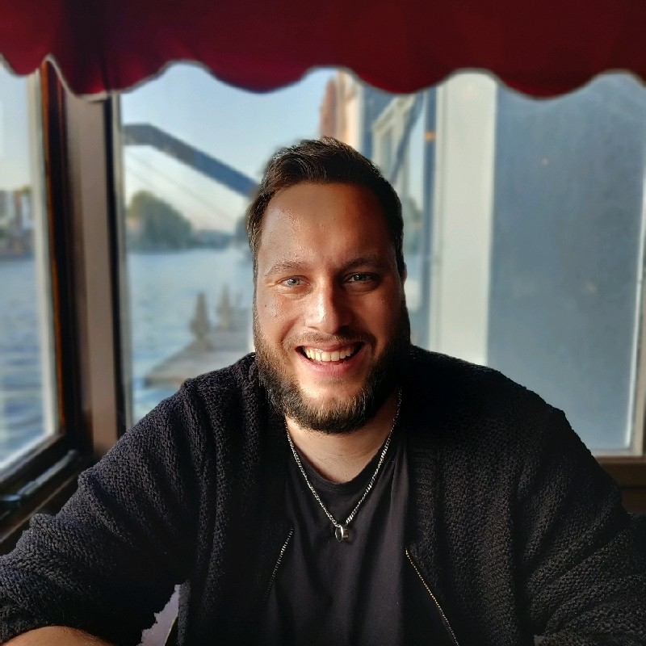
Studenten

Slide 10
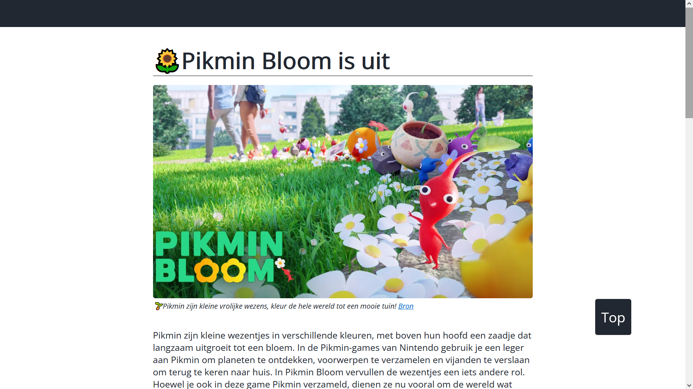

Slide 11
https://blog.mediacollege.work

Slide 12
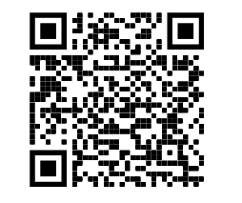
Notes:
https://web.microsoftstream.com/video/3fd7e012-58f1-48d7-97dd-cff450280ab6

